Slide 1
Data Curation Project: Movies in the Park

Slide 2
Dataset
Movies Daily Update Dataset (kaggle.com)
~350 MB
20 columns containing metadata for each movie
>700,00 rows of movie data collected from the TMDB database
The Movie Database (TMDB) is a popular, user editable database for movies and TV shows.

Slide 3
Description of Dataset
Original Attributes
'Id'
'Title'
'Genres'
'Original_language'
'Overview'
'popularity'
'Release_date'
'Budget'
'Revenue'
‘Runtime’
‘Status’
‘Tagline’
‘Vote_average’
‘Vote_count’
‘Credits’
‘Keywords’
‘Poster_path’
‘Backdrop_path’
‘Recommendations’

Slide 4
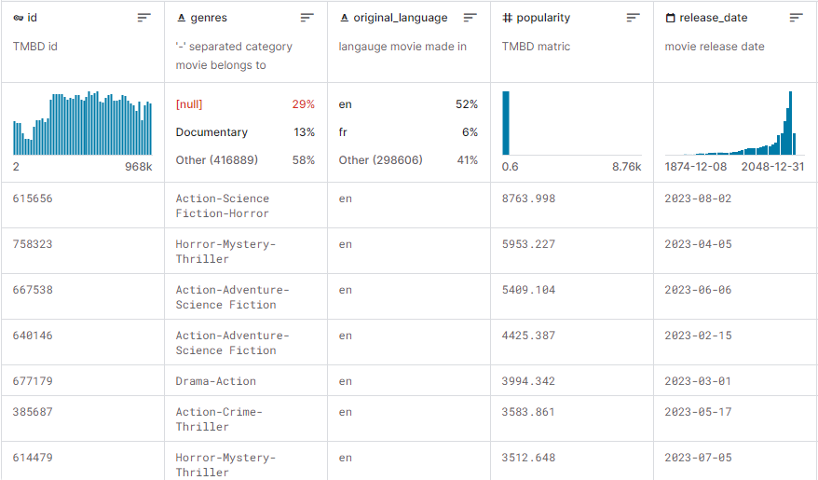
Dataset Snapshot

Slide 5
Initial Steps
Check for null values in the larger dataset using Jupyter notebook – the file is too large for Vizier (100MB cap)
Remove columns that are largely null values or unhelpful for our end goal
Remaining attributes: 'id', 'title', 'genres', 'original_language', 'overview', 'popularity', 'release_date', 'budget', 'revenue', 'runtime', 'status', 'vote_average', 'vote_count'
Choose the first 250,000 values to lower the size down to ~90MB

Slide 6
Data Quality Issues
Status column contains 99.4% released movies and five other different responses
Recommendations column contains 95% missing values
Some entry values appear to be invalid or outliers
Many movies have a runtime of 0 minutes
However, upon closer look there is a valid entry for a documentary with a runtime of 51,420 minutes
The average vote rating is default 0 if there are no voters

Slide 7
Data Quality Solutions
Missing values:
Column-specific answers, e.g. for column vote_average the values can only be from 0 to 10
Some can be filled with column mean/mode
Some columns can be deleted due to its inefficiency
Outliers:
Filled with column mean/mode
Some extreme values can be removed – unfortunately this means the record-breaking entry with a runtime of 51,420 minutes will be removed

